Slide 1
Continuation of Detection and Counting of nano/macro particles found in Stage I Lung cancer patients (Before/After Treatment)
Pres. by Nareg Ohannesian
02-11-2022

Slide 2
Experimental Details for plasma lung cancer stage one plasma
Used samples: A lot.
Plasma volume: 20 µl.
Type of Cancer: unknown.
Concentration: unknown.
Size Distribution: unknown.
Experimental duration: 60 min.
Antibody used: CD9, CD81, and CD63.

Slide 3
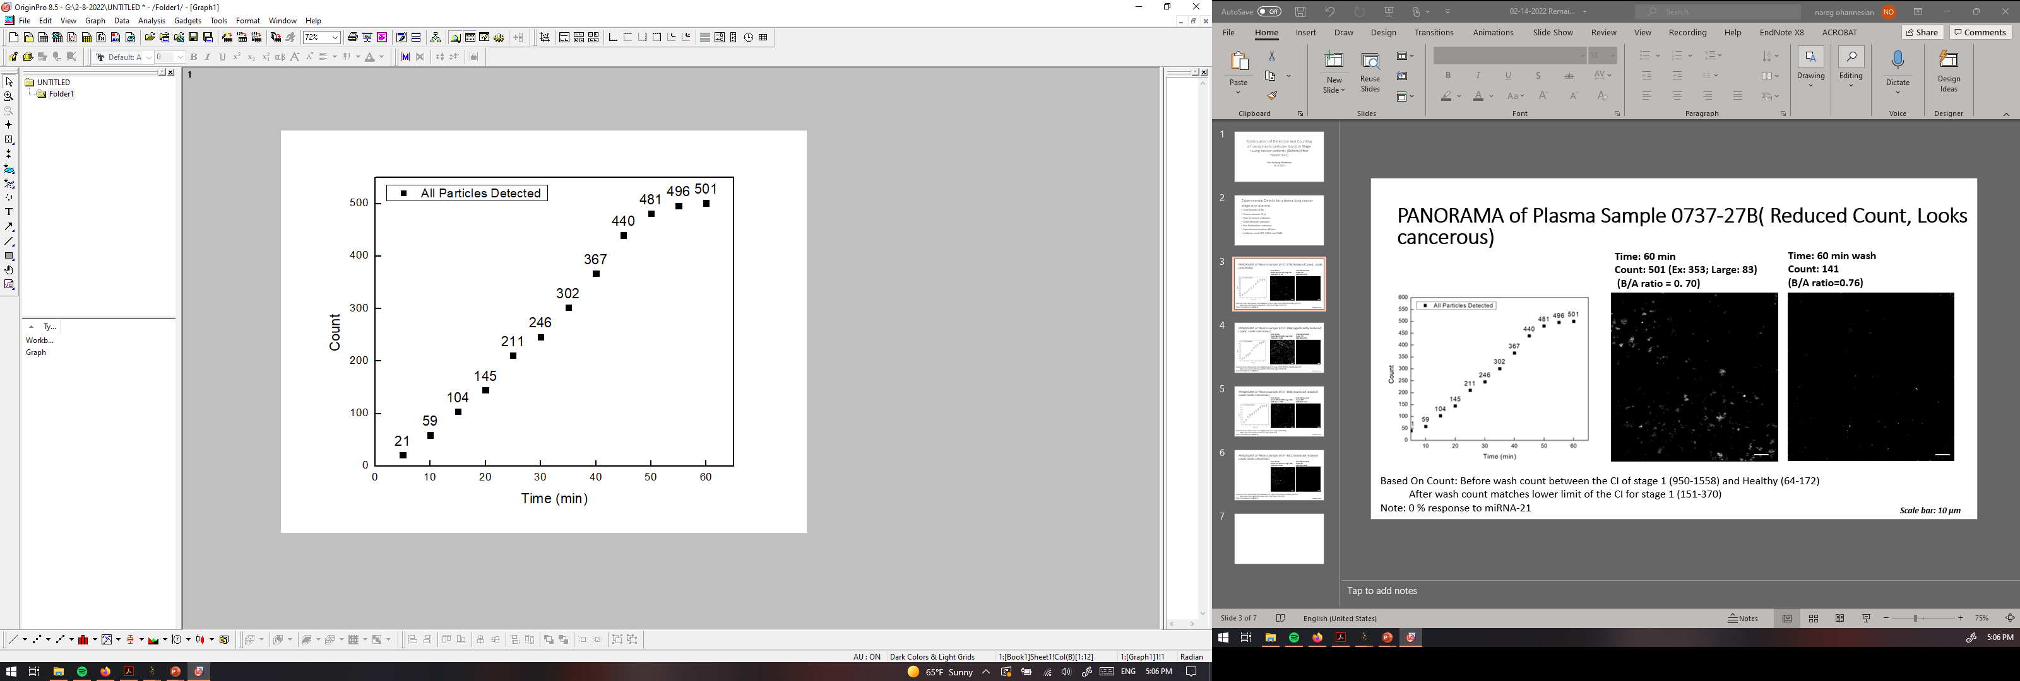
PANORAMA of Plasma Sample 0737-27B( Reduced Count, Looks cancerous)
Time: 60 min
Count: 501 (Ex: 353; Large: 83)
(B/A ratio = 0. 70)
Time: 60 min wash
Count: 141
(B/A ratio=0.76)
Based On Count: Before wash count between the CI of stage 1 (950-1558) and Healthy (64-172)
After wash count matches lower limit of the CI for stage 1 (151-370)
Note: 0 % response to miRNA-21
Scale bar: 10 µm

Slide 4

PANORAMA of Plasma Sample 0737-29B( Significantly Reduced Count, Looks cancerous)
Time: 60 min
Count: 844 (Ex: 434; Large: 410)
(B/A ratio = 0.42)
Time: 60 min wash
Count: 137
(B/A ratio=0.55)
Based On Count: Before wash count slightly lower CI of stage 1 (950-1558) and Healthy (64-172)
After wash count matches lower limit of the CI for stage 1 (151-370)
Note: 0 % response to miRNA-21
Scale bar: 10 µm

Slide 5


PANORAMA of Plasma Sample 0737-30B( Increased retained count, looks cancerous)
Time: 60 min
Count: 758 (Ex: 488; Large: 270)
(B/A ratio = 1.02)
Time: 60 min wash
Count: 229
(B/A ratio=1.77)
Based On Count: Before wash count slightly lower CI of stage 1 (950-1558)
After wash count matches the CI for stage 1 (151-370)
Note: 0 % response to miRNA-21
Scale bar: 10 µm

Slide 6
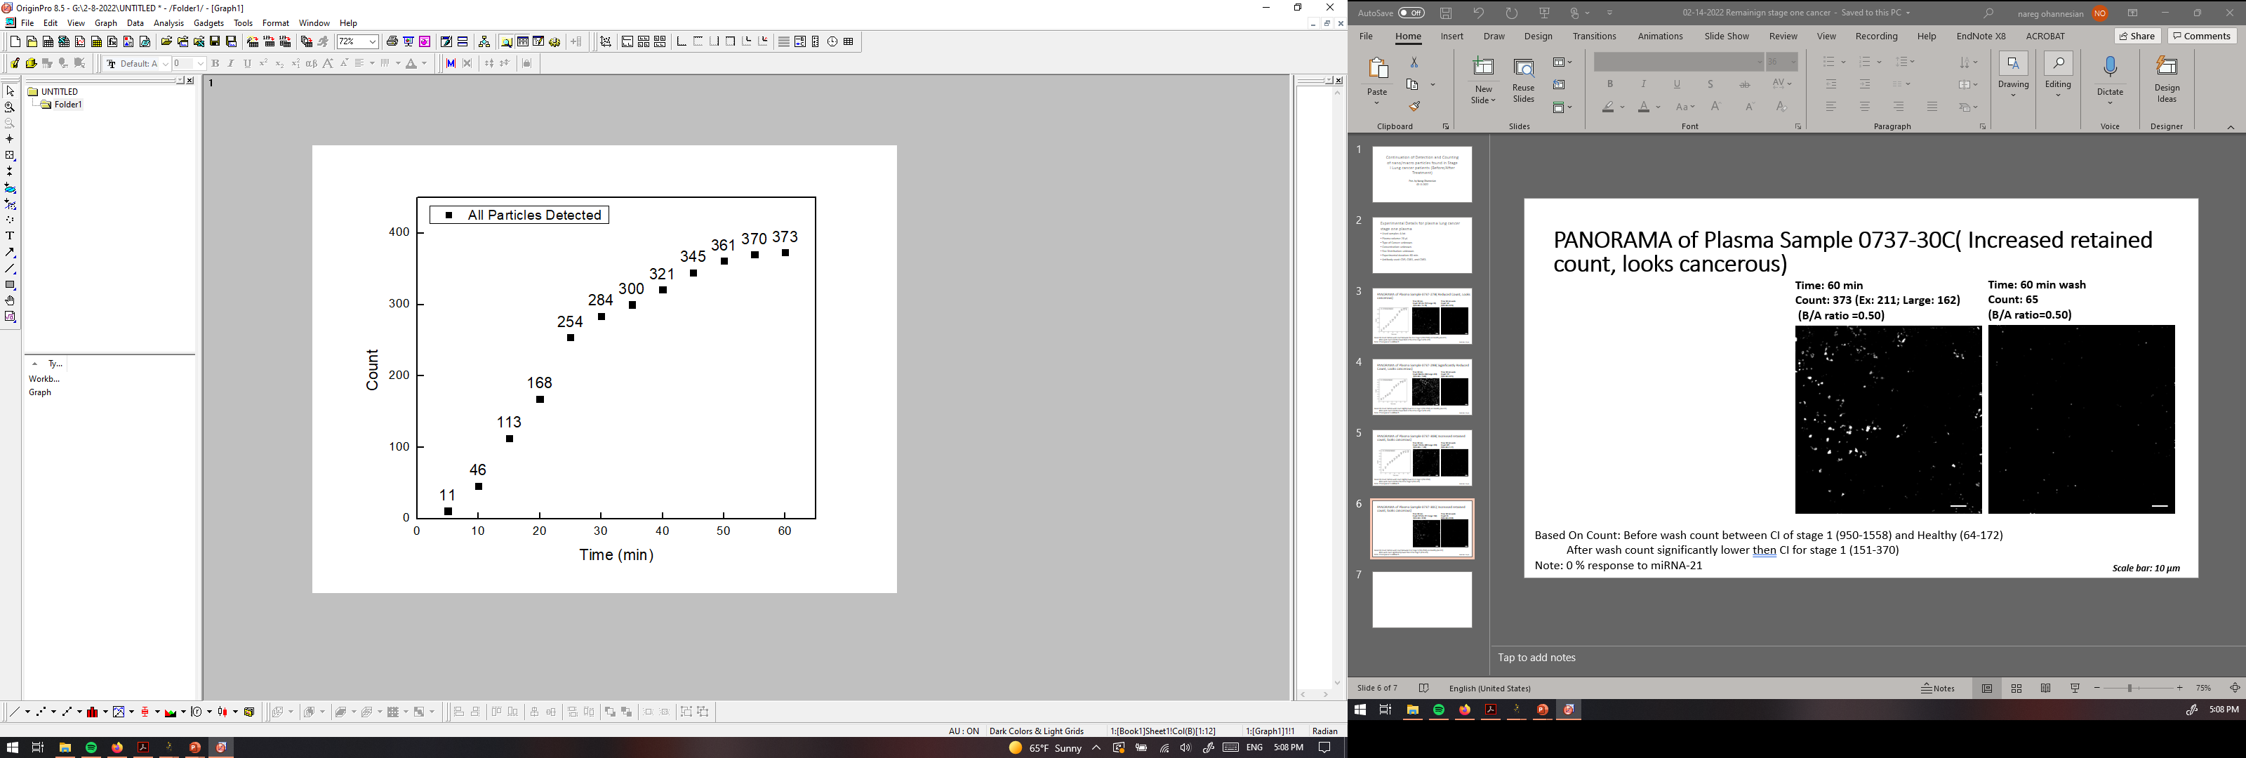

PANORAMA of Plasma Sample 0737-30C( Reduced count, looks healthy)
Time: 60 min
Count: 373 (Ex: 211; Large: 162)
(B/A ratio =0.50)
Time: 60 min wash
Count: 65
(B/A ratio=0.50)
Based On Count: Before wash count between CI of stage 1 (950-1558) and Healthy (64-172)
After wash count significantly lower than CI for stage 1 (151-370)
Note: 0 % response to miRNA-21
Scale bar: 10 µm

Slide 7
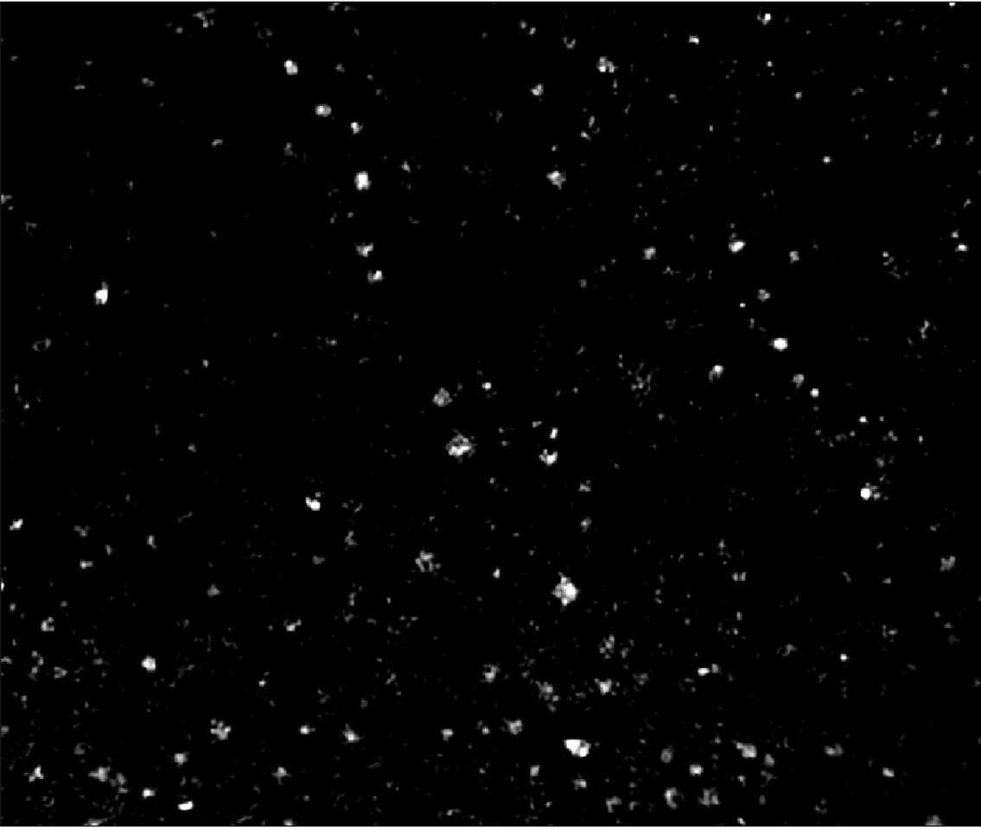
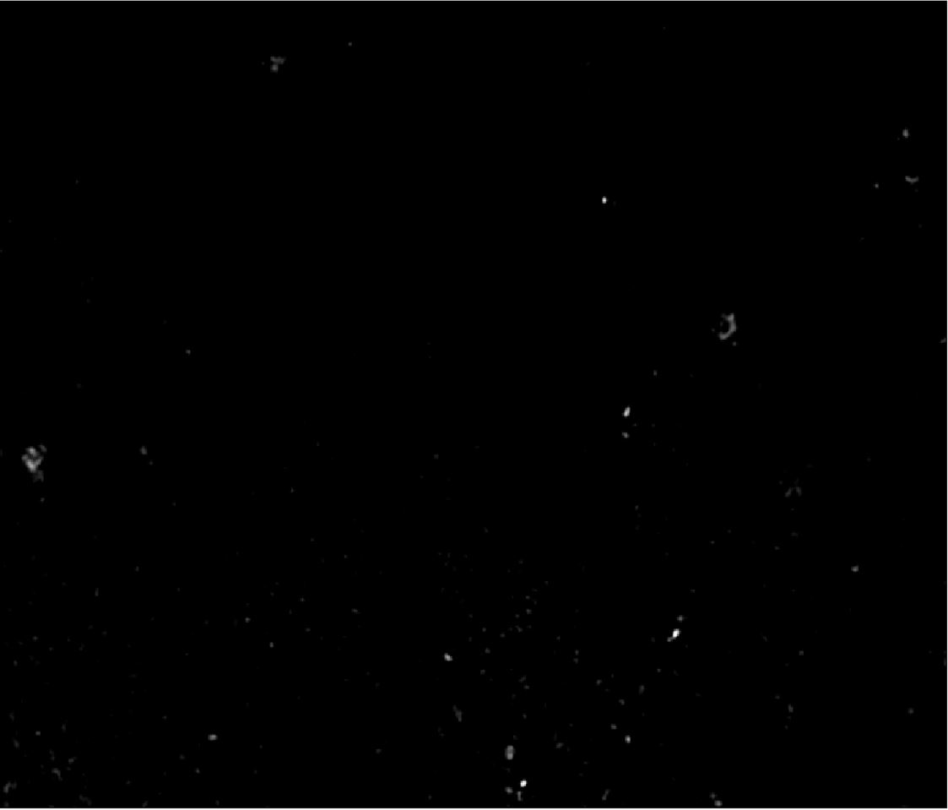
PANORAMA of Plasma Sample 0737-31B( Reduced count; Ratio: Healthy; Count: Cancer 12%)
Time: 60 min
Count: 436 (Ex: 369; Large: 67)
(B/A ratio =0.48)
Time: 60 min wash
Count: 97
(B/A ratio=0.32)
Based On Count: Before wash count between CI of stage 1 (950-1558) and Healthy (64-172)
After wash count slighlty lower than CI for stage 1 (151-370)
Note: 0 % response to miRNA-21
Scale Bar: 10 µm

Slide 8
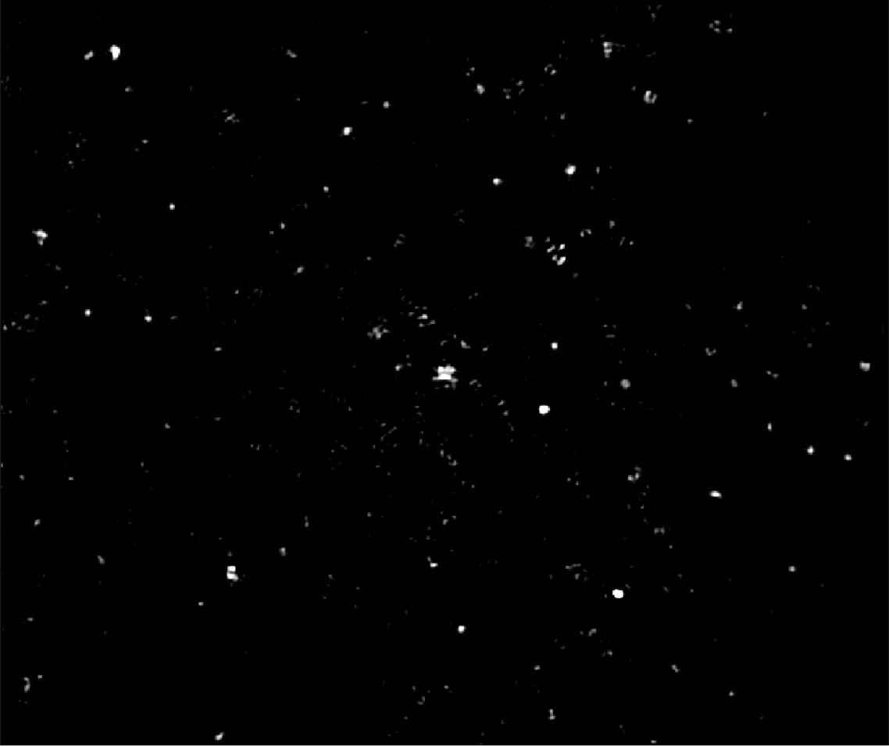

PANORAMA of Plasma Sample 0737-31C( Reduced count; Ratio: Healthy; Count: Cancer 13%)
Time: 60 min
Count: 304 (Ex: 251; Large: 53)
(B/A ratio =0.33)
Time: 60 min wash
Count: 98
(B/A ratio=0.32)
Based On Count: Before wash count between CI of stage 1 (950-1558) and Healthy (64-172)
After wash count lower than CI for stage 1 (151-370)
Note: 0 % response to miRNA-21
Scale Bar: 10 µm

Slide 9
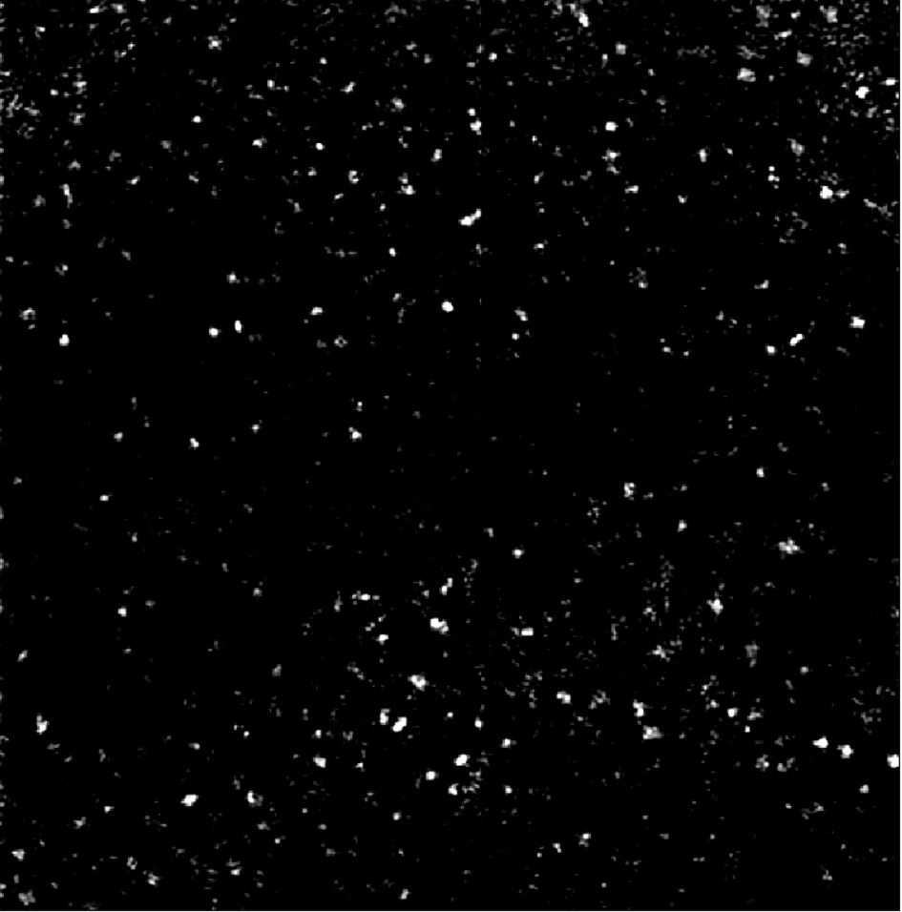

PANORAMA of Plasma Sample 0737-34B( Reduced count; looks cancerous)
Time: 60 min
Count: 505 (Ex: 424; Large: 81)
(B/A ratio =0.24)
Time: 60 min wash
Count: 155
(B/A ratio=1.0064)
Based On Count: Before wash count between CI of stage 1 (950-1558) and Healthy (64-172)
After wash count matches CI for stage 1 (151-370)
Note: 0 % response to miRNA-21
Scale Bar: 10 µm

Slide 10
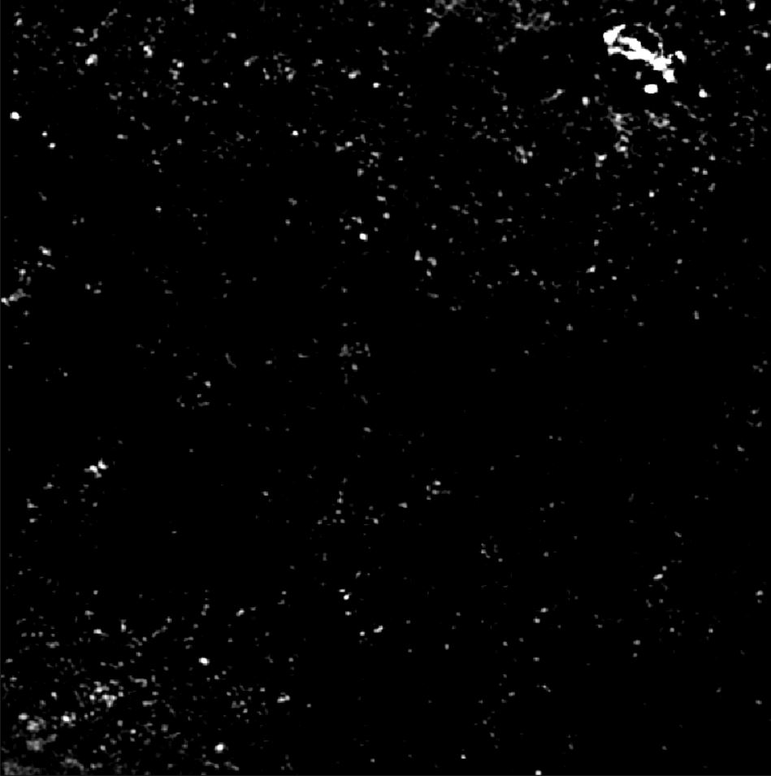
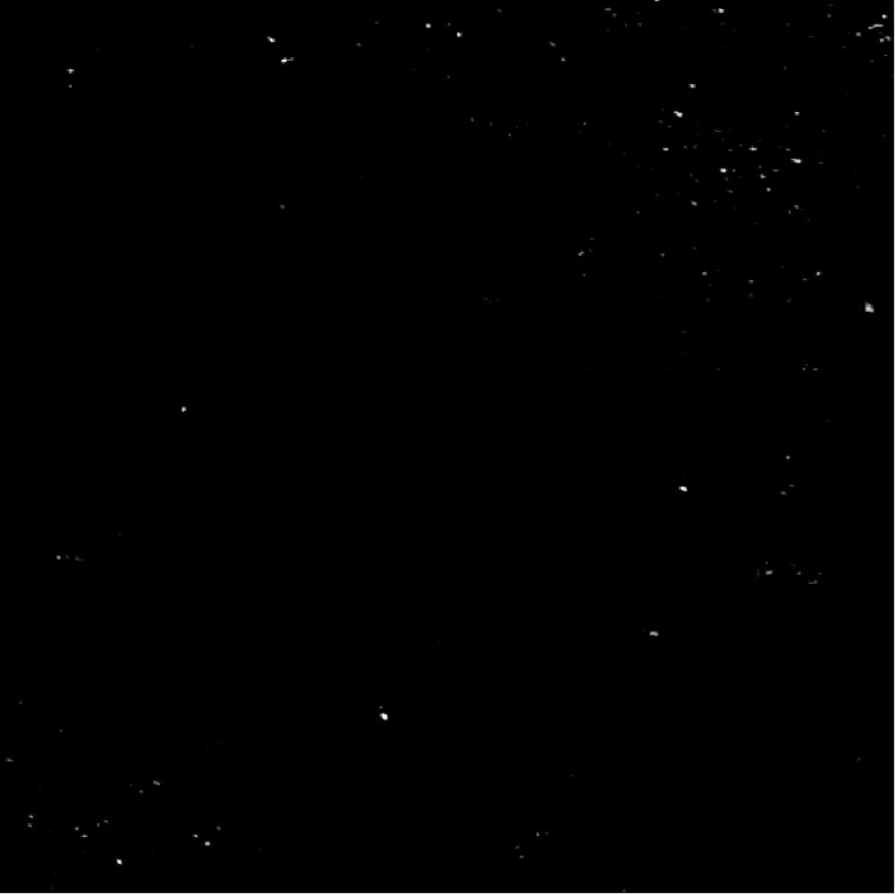
PANORAMA of Plasma Sample 0737-35B( Reduced count; looks cancerous)
Time: 60 min
Count: 557 (Ex: 509; Large: 48)
(B/A ratio =0.44)
Time: 60 min wash
Count: 145
(B/A ratio=1.38)
Based On Count: Before wash count between CI of stage 1 (950-1558) and Healthy (64-172)
After wash count slighlty lower than CI for stage 1 (151-370)
Note: 0 % response to miRNA-21
Scale Bar: 10 µm

Slide 11


PANORAMA of Plasma Sample 0737-35C( Reduced count; Ratio: Healthy; Count: Healthy 10%)
Time: 60 min
Count: 332 (Ex: 302; Large: 30)
(B/A ratio =0.26)
Time: 60 min wash
Count: 84
(B/A ratio=0.8)
Based On Count: Before wash count between CI of stage 1 (950-1558) and Healthy (64-172)
After wash count lower than CI for stage 1 (151-370)
Note: 0 % response to miRNA-21
Scale Bar: 10 µm

Slide 12
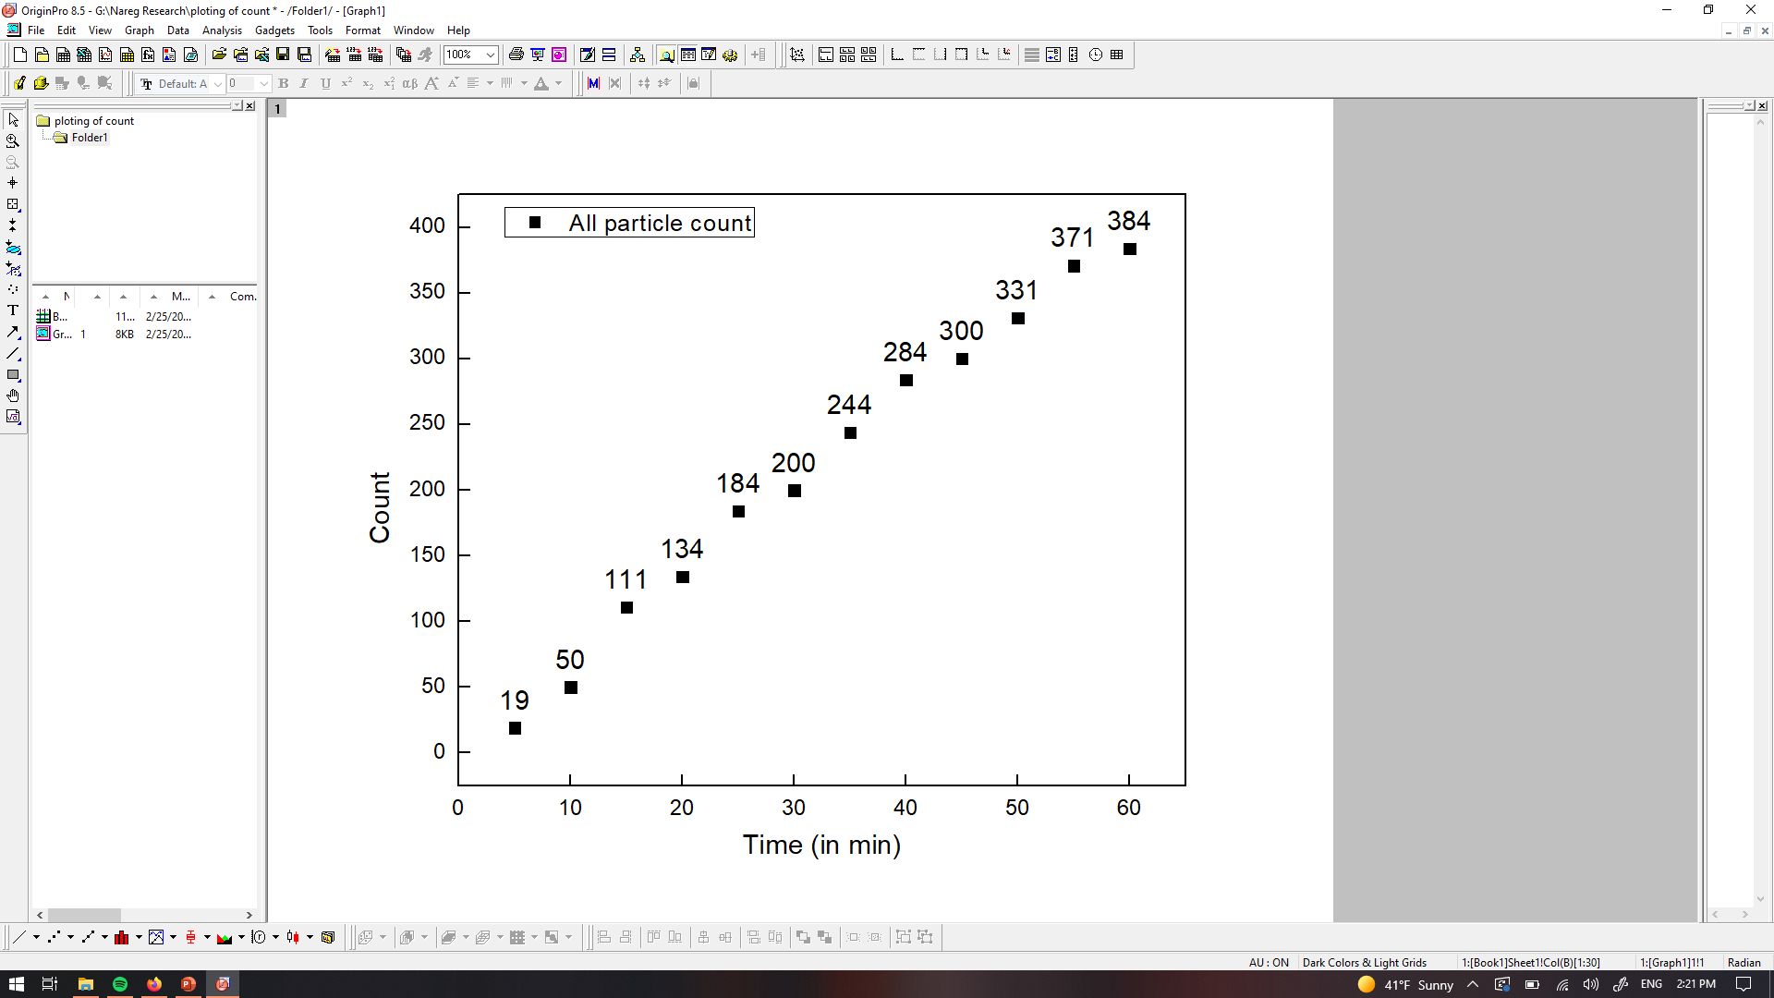

PANORAMA of Plasma Sample 0737-41C( Reduced count, looks healthy)
Time: 60 min
Count: 384 (Ex: 311; Large: 73)
(B/A ratio =0.31)
Time: 60 min wash
Count: 72
(B/A ratio=0.65)
Based On Count: Before wash count between CI of stage 1 (950-1558) and Healthy (64-172)
After wash count significantly lower than CI for stage 1 (151-370)
Note: 0 % response to miRNA-21
Scale bar: 10 µm

Slide 13
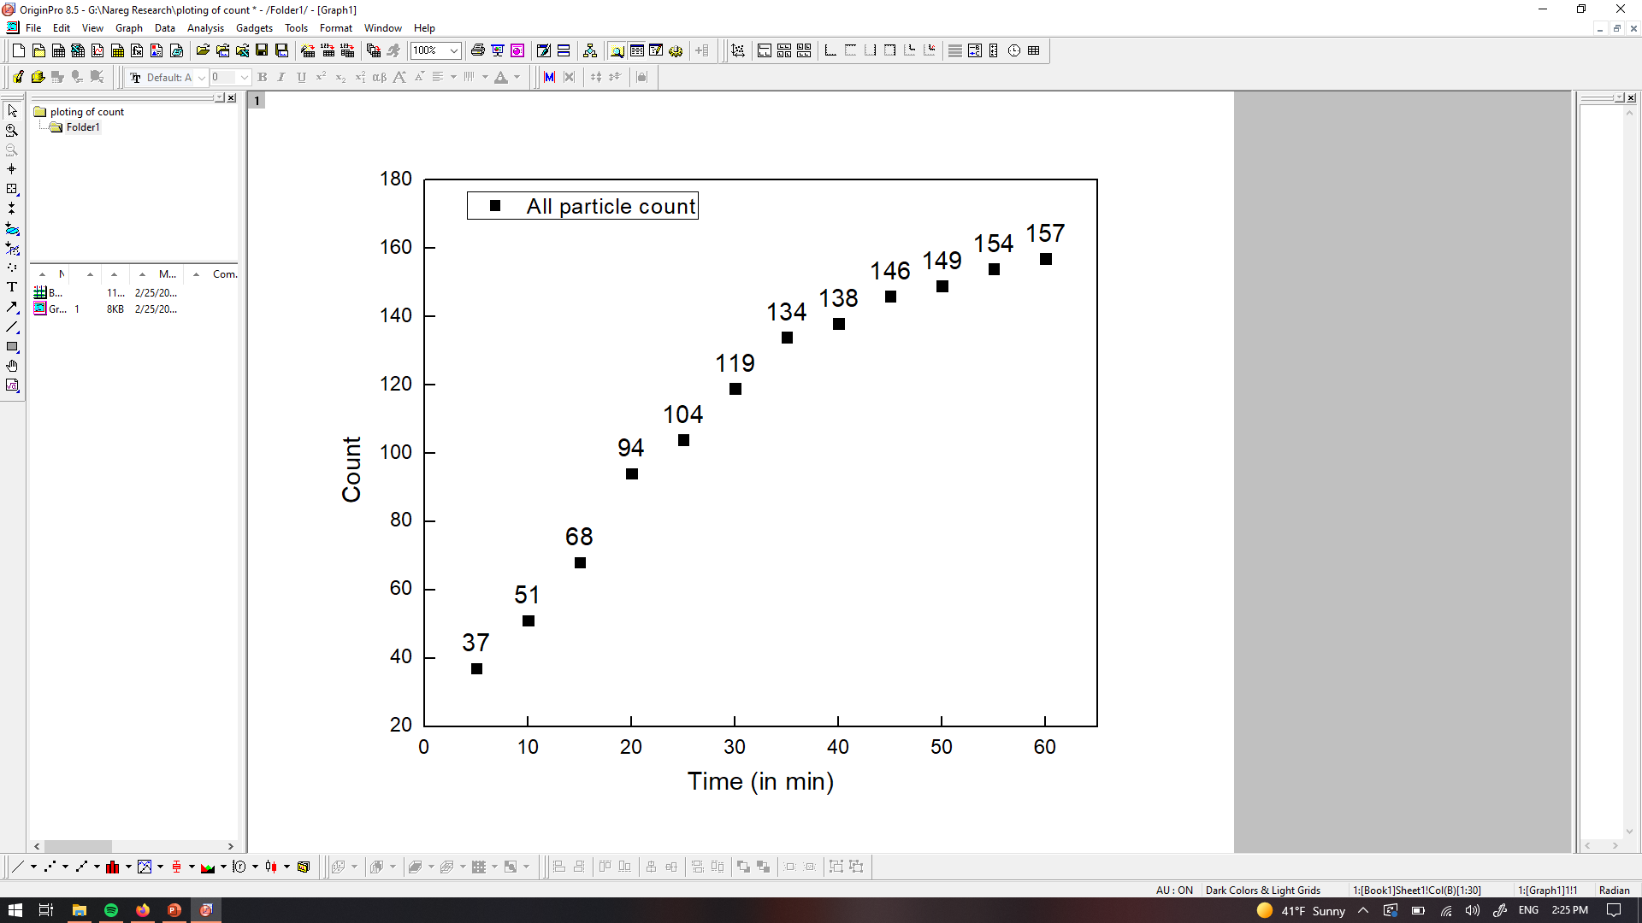

PANORAMA of Plasma Sample 0737-43B( Significant reduced count, looks healthy)
Time: 60 min
Count: 157 (Ex: 111; Large: 46)
(B/A ratio =0.14)
Time: 60 min wash
Count: 47
(B/A ratio=0.17)
Based On Count: Before wash count matches CI of Healthy (64-172)
After wash count slightly higher than CI for healthy (8-30)
Note: 0 % response to miRNA-21
Scale bar: 10 µm

Slide 14
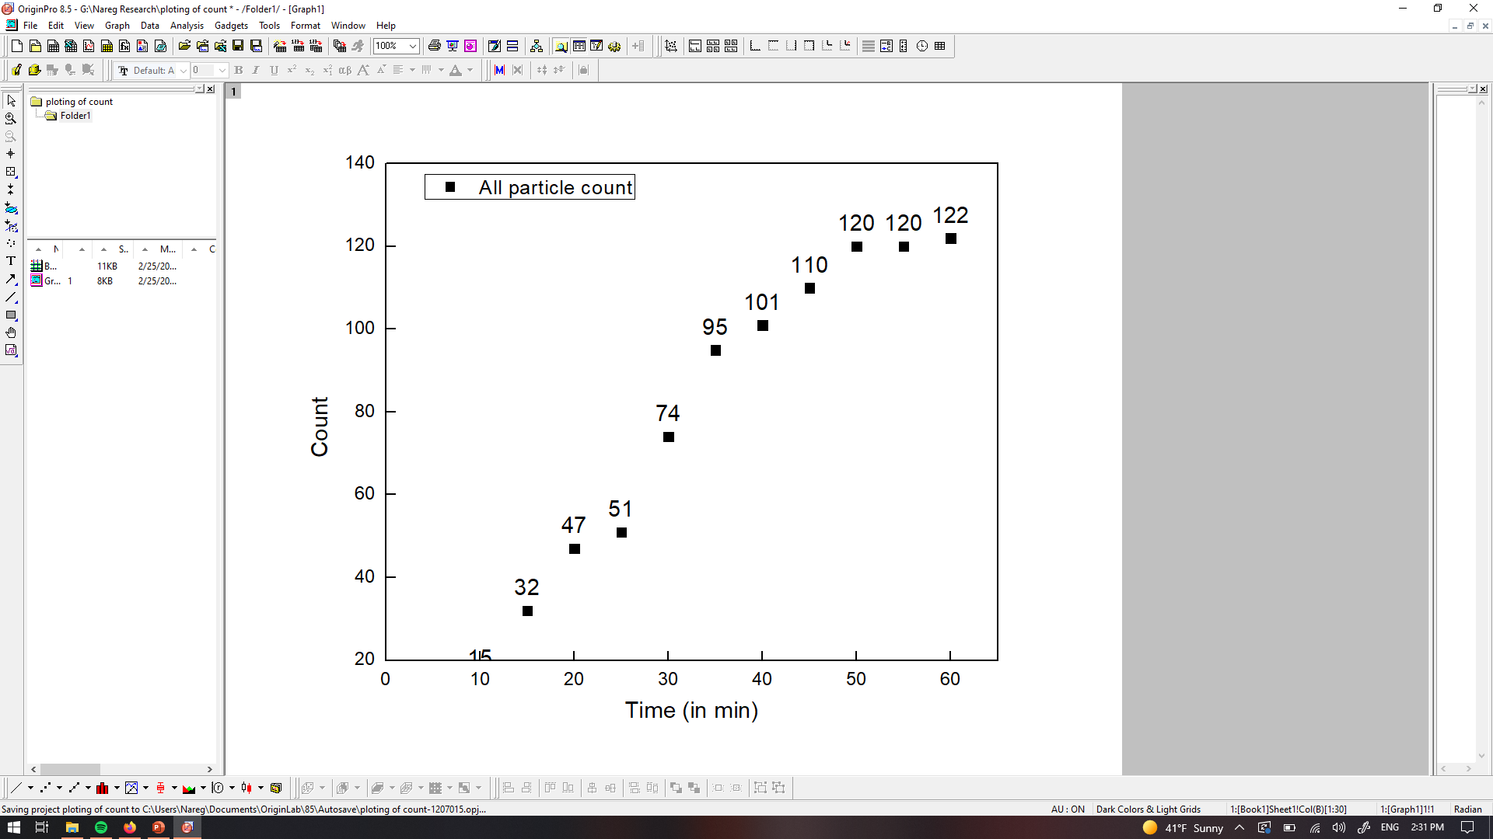

PANORAMA of Plasma Sample 0737-47B (Significantly reduced count, looks healthy)
Time: 60 min
Count: 122 (Ex: 76; Large: 46)
(B/A ratio =0.06)
Time: 60 min wash
Count: 40
(B/A ratio=0.11)
Based On Count: Before wash count matches CI of Healthy (64-172)
After wash count slightly higher than CI for healthy (8-30)
Note: 0 % response to miRNA-21
Scale bar: 10 µm

Slide 15
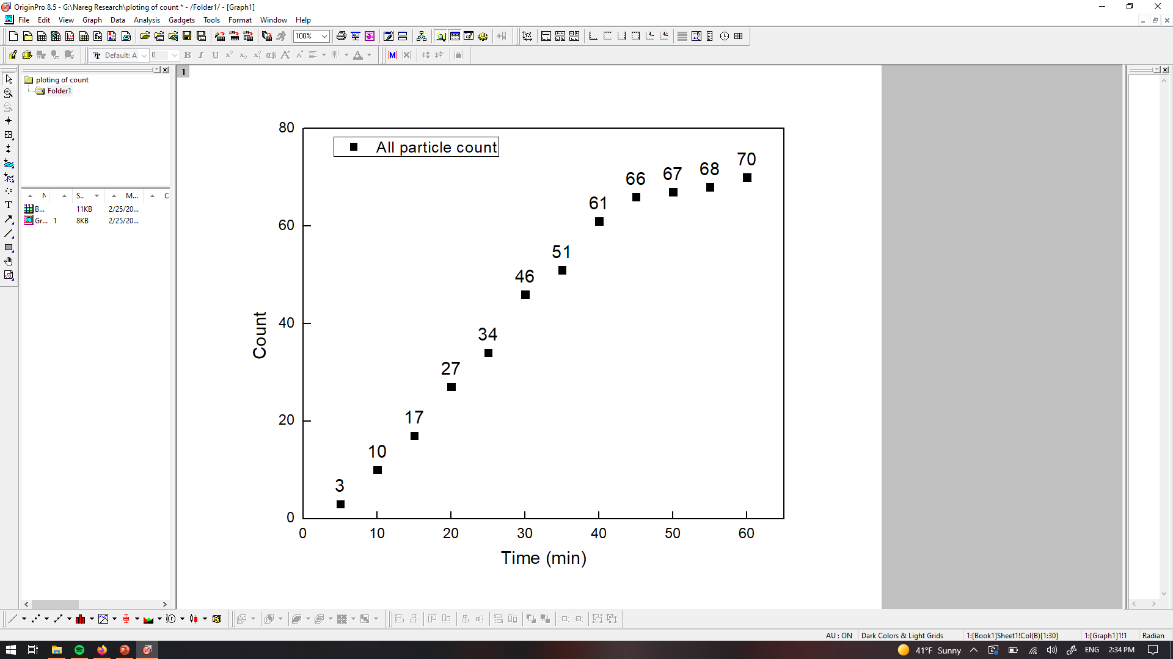
PANORAMA of Plasma Sample 0737-47C (Significantly reduced count, looks healthy)
Time: 60 min
Count: 70 (Ex: 64; Large: 6)
(B/A ratio =0.03)
Time: 60 min wash
Count: 22
(B/A ratio=0.06)
Based On Count: Before wash count matches CI of Healthy (64-172)
After wash count matches CI for healthy (8-30)
Note: 0 % response to miRNA-21
Scale bar: 10 µm

Slide 16
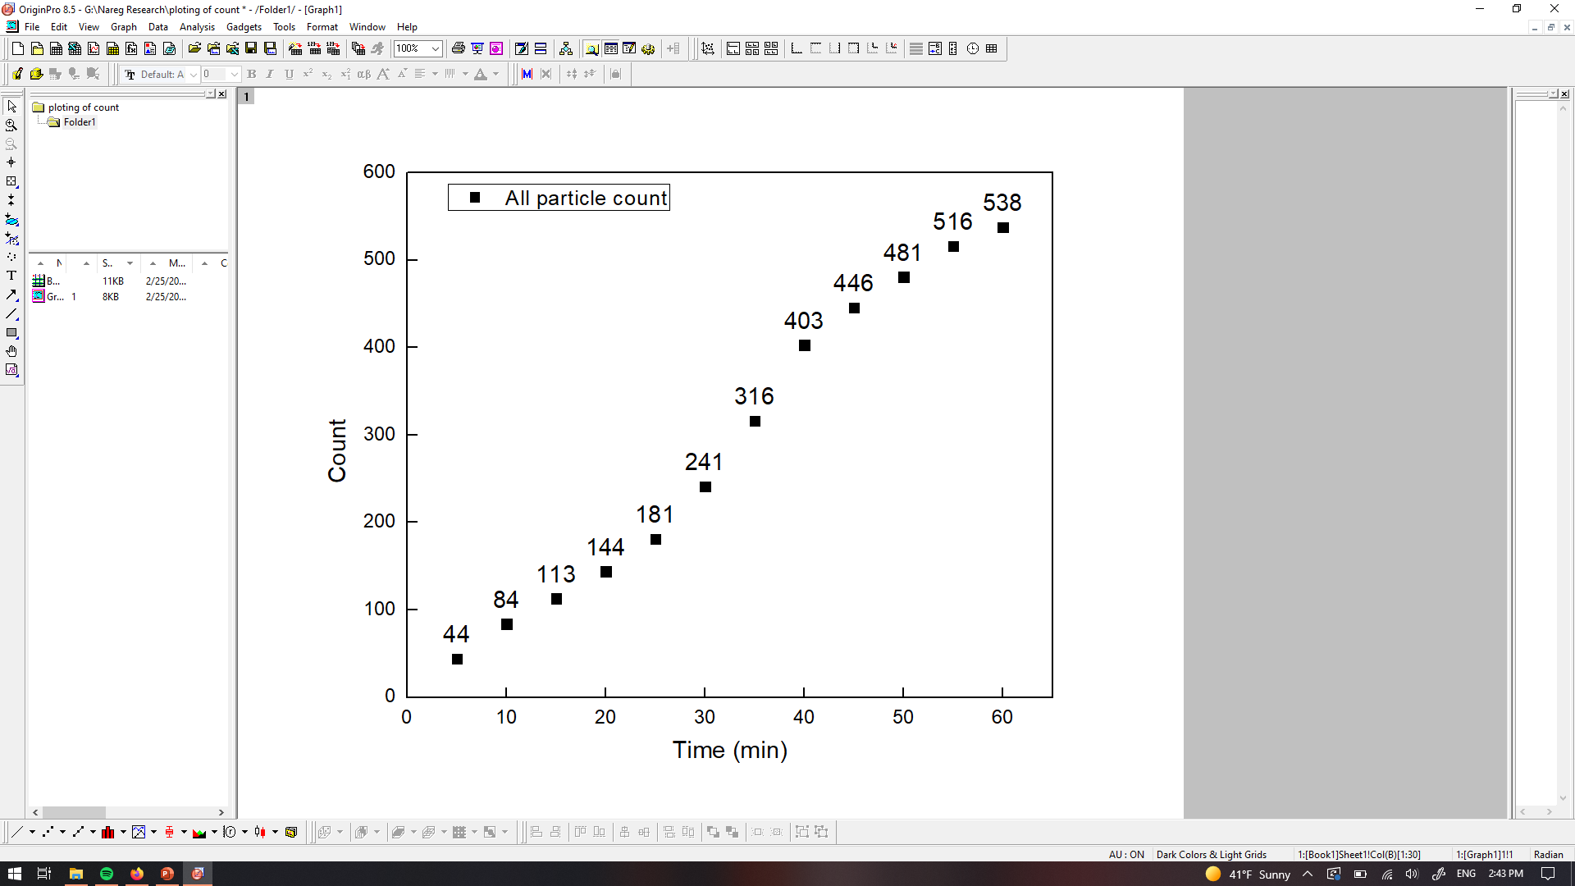
PANORAMA of Plasma Sample 0737-48B ( Reduced count, looks Cancerous)
Time: 60 min
Count: 538 (Ex: 393; Large: 145)
(B/A ratio =0.68)
Time: 60 min wash
Count: 163
(B/A ratio=1.065)
Based On Count: Before wash count between CI of stage 1 (950-1558) and Healthy (64-172)
After wash count matches CI for stage 1 (151-370)
Note: 0 % response to miRNA-21
Scale bar: 10 µm

Slide 17
Previous Set: Comparison of particle/exosome counts before and after treatment
Patient | All | Large | Exosome all | Captured Exosomes | Prediction Ratio Based | Count based
2 (C/A) | 0.699689 | 2.351351 | 0.551791 | 0.39980916 | Cancer | Cancer
2 (D/A) | 0.266104 | 1.183784 | 0.18393 | 0.078244275 | Healthy | Healthy
7 (C/A) | 0.982242 | 0.73 | 1.48505 | 1.2 | Cancer | Cancer
8 (B/A) | 0.491314 | 0.223224 | 0.740314 | 1.076923077 | Cancer | Cancer
8 (C/A) | 0.599891 | 0.507328 | 0.685864 | 0.601809955 | Healthy | Cancer (72%)
9 (B/A) | 0.664384 | 0.544762 | 0.774561 | 1.259911894 | Cancer | Cancer
9 (C/A) | 0.285845 | 0.300952 | 0.27193 | 0.240088106 | Healthy | Cancer (32%)
11 (B/A) | 2.608889 | 2.436285 | 2.72549 | 1.81981982 | Cancer | Cancer
11 (C/A) | 0.877333 | 0.388769 | 1.217195 | 0.510510511 | Healthy | Cancer
11 (D/A) | 0.944889 | 0.466523 | 1.277526 | 0.399399399 | Healthy | Cancer (72%)
13 (B/A) | 1.676647 | 1.287879 | 1.98645 | 1.170542636 | Cancer | Cancer
13 (C/A) | 0.203593 | 0.280303 | 0.176152 | 0.372093023 | Healthy | Healthy
13 (D/A) | 1.235529 | 1.659091 | 1.097561 | 0.596899225 | Healthy | Healthy
17 (B/A) | 1.428983 | 1.115502 | 1.718224 | 1.105769231 | Cancer | Cancer (42%)
17 (C/A) | 0.747601 | 0.610942 | 0.885145 | 0.778846154 | Healthy | Healthy (15%)
19 (B/A) | 0.771178 | 1.8 | 0.602041 | 0.610497238 | Healthy | Cancer
19 (C/A) | 0.231743 | 0.206897 | 0.235828 | 0.091160221 | Healthy | Healthy
24 (B/A) | 1.224762 | 1.005319 | 1.347181 | 1.963302752 | Cancer | Cancer
24 (C/A) | 1.779048 | 1.569149 | 1.896142 | 1.009174312 | Cancer | Cancer (33%)
25 (B/A) | 0.906141 | 0.777328 | 0.957792 | 0.734939759 | Healthy | Cancer (54%)
25 (C/A) | 0.38007 | 0.267206 | 0.425325 | 0.765060241 | Healthy | Cancer (61%)

Slide 18
New Set: Comparison of particle/exosome counts before and after treatment
Patient | All | Large | Exosome all | Captured Exosomes | Prediction Ratio BaseD | Count based
27(B/A) | 0.703652 | 0.394667 | 1.017291 | 0.766304 | Healthy | Cancer (85%)
29(B/A) | 0.429954 | 0.438503 | 0.422179 | 0.554656 | Healthy | Cancer (78%)
30(B/A) | 1.024324 | 1.98374 | 0.242915 | 1.775194 | Cancer | Cancer
30(C/A) | 0.504054 | 0.658537 | 0.427126 | 0.503876 | Healthy | Healthy (42%)
31(B/A) | 0.484444 | 0.335 | 0.467089 | 0.320132 | Healthy | Cancer (12%)
31(C/A) | 0.337778 | 0.265 | 0.317722 | 0.323432 | Healthy | Cancer (13%)
34(B/A) | 0.245623 | 0.055594 | 0.658385 | 1.006494 | Cancer | Cancer
35(B/A) | 0.441363 | 0.081494 | 0.756315 | 1.380952 | Cancer | Cancer (91%)
35(C/A) | 0.263074 | 0.050934 | 0.448737 | 0.8 | Healthy | Healthy (10%)
41(C/A) | 0.314239 | 0.365 | 0.304305 | 0.654545 | Healthy | Healthy (30%)
43(B/A) | 0.146866 | 0.126374 | 0.157447 | 0.176692 | Healthy | Healthy (71%)
47(B/A) | 0.05793 | 0.050383 | 0.063705 | 0.112045 | Healthy | Healthy (83%)
47(C/A) | 0.033238 | 0.006572 | 0.053646 | 0.061625 | Healthy | Healthy
48(B/A) | 0.683609 | 0.878788 | 0.631833 | 1.065359 | Cancer | Cancer

